Slide 1

Parallel Programming in C with MPI and OpenMP
Michael J. Quinn

Slide 2
Chapter 11
Matrix Multiplication

Slide 3
Outline
Sequential algorithms
  Iterative, row-oriented
  Recursive, block-oriented
Parallel algorithms
  Rowwise block striped decomposition
  Cannon’s algorithm

Slide 4
Iterative, Row-oriented Algorithm
Series of inner product (dot product) operations
×
=

Slide 5
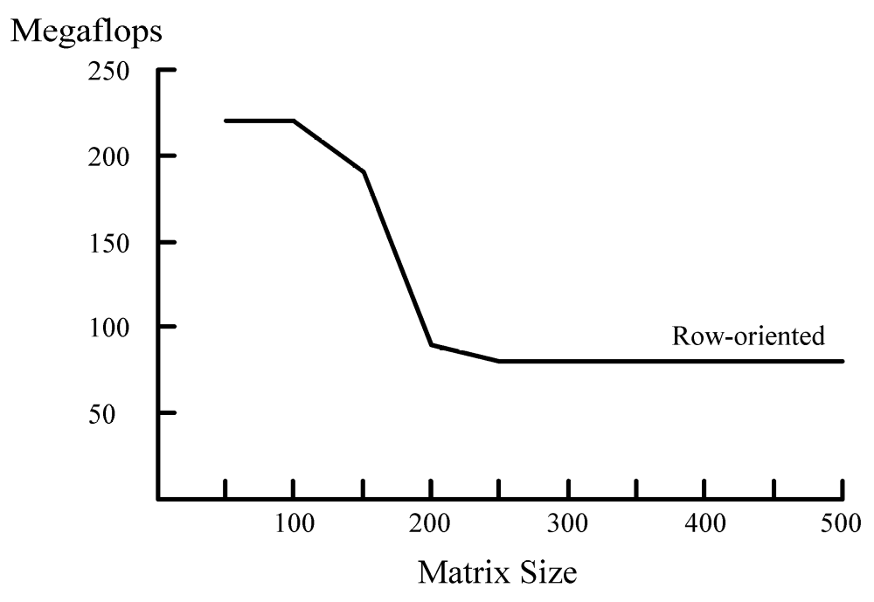
Performance as n Increases

Slide 6
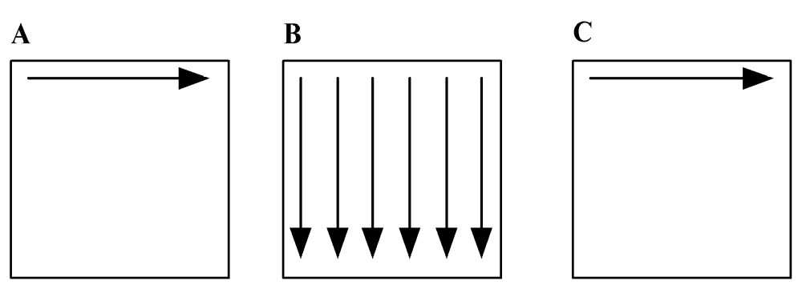
Reason:
Matrix B Gets Too Big for Cache
Computing a row of C requires accessing every element of B

Slide 7
Block Matrix Multiplication
Replace scalar multiplication with matrix multiplication
Replace scalar addition with matrix addition
×
=

Slide 8
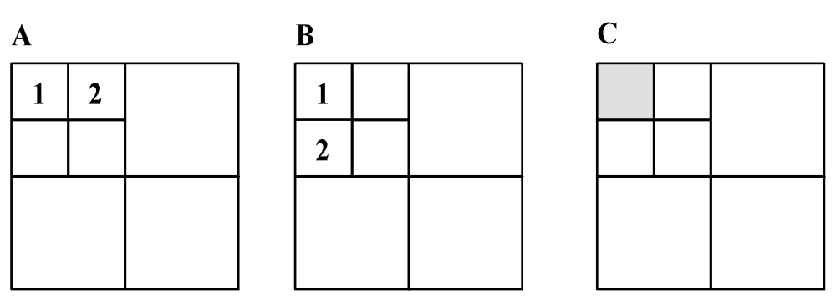
Recurse Until B Small Enough

Slide 9
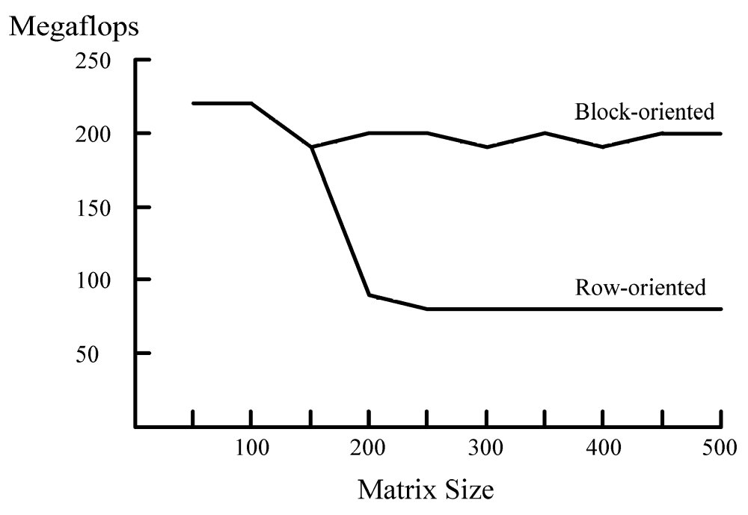
Comparing Sequential Performance

Slide 10
First Parallel Algorithm
Partitioning
  Divide matrices into rows
  Each primitive task has corresponding rows of three matrices
Communication
  Each task must eventually see every row of B
  Organize tasks into a ring

Slide 11
First Parallel Algorithm (cont.)
Agglomeration and mapping
  Fixed number of tasks, each requiring same amount of computation
  Regular communication among tasks
  Strategy: Assign each process a contiguous group of rows

Slide 12
Communication of B (1)
A
A
A
B
C
A
B
C
A
A
A
B
C
A
B
C

Slide 13
Communication of B (2)
A
A
A
B
C
A
B
C
A
A
A
B
C
A
B
C

Slide 14
Communication of B (3)
A
A
A
B
C
A
B
C
A
A
A
B
C
A
B
C

Slide 15
Communication of B (4)
A
A
A
B
C
A
B
C
A
A
A
B
C
A
B
C

Slide 16
Complexity Analysis
Algorithm has p iterations
During each iteration a process multiplies
(n / p) × (n / p) block of A by (n / p) × n block of B: Θ(n³ / p²)
Total computation time: Θ(n³ / p)
Each process ends up passing
(p – 1)n²/p = Θ(n²) elements of B

Slide 17
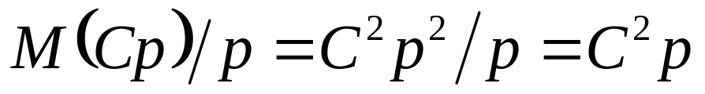
Isoefficiency Analysis
Sequential algorithm: Θ(n³)
Parallel overhead: Θ(pn²)
Isoefficiency relation: n³ ≥ Cpn² ⇒ n ≥ Cp
This system does not have good scalability

Slide 18
Weakness of Algorithm 1
Blocks of B being manipulated have p times more columns than rows
Each process must access every element of matrix B
Ratio of computations per communication is poor: only 2n / p

Slide 19
Parallel Algorithm 2
(Cannon’s Algorithm)
Associate a primitive task with each matrix element
Agglomerate tasks responsible for a square (or nearly square) block of C
Computation-to-communication ratio rises to n / √p

Slide 20
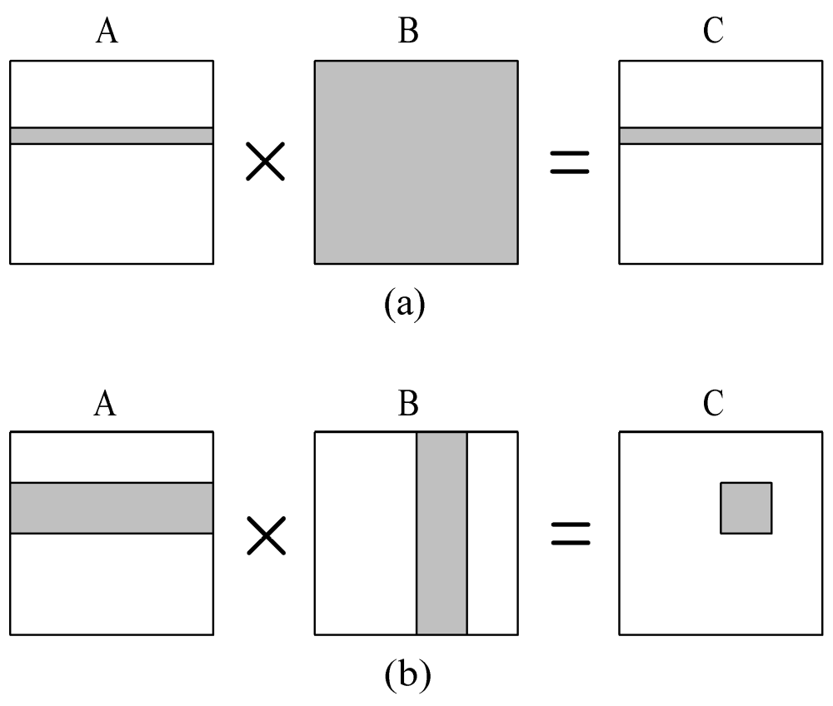
Elements of A and B Needed to Compute a Process’s Portion of C
Algorithm 1
Cannon’s
Algorithm

Slide 21
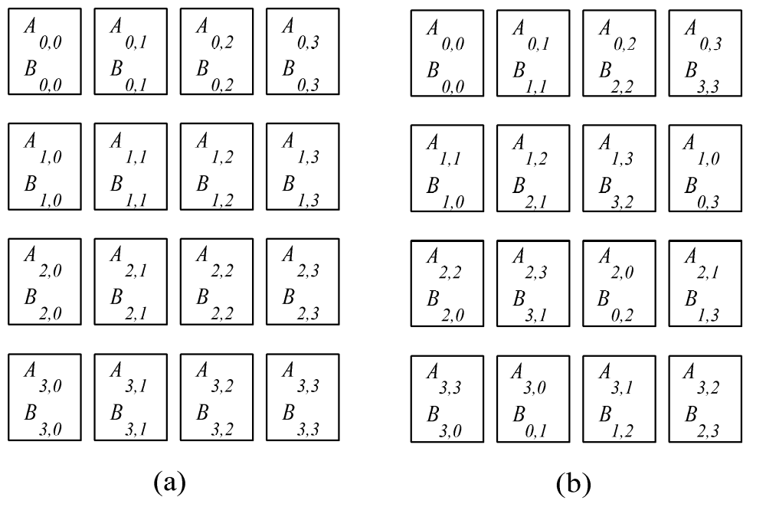
Blocks Must Be Aligned
Before
After

Slide 22
Blocks Need to Be Aligned
Each triangle represents a matrix block
Only same-color triangles should be multiplied
B00
B01
B02
B03
A00
A01
A02
A03
B10
B11
B12
B13
A10
A11
A12
A13
B20
B21
B22
B23
A20
A21
A22
A23
B30
B31
B32
B33
A30
A31
A32
A33

Slide 23
Rearrange Blocks
B00
B11
B22
B33
A00
A01
A02
A03
Block Aij cycles
left i positions
Block Bij cycles
up j positions
B10
B21
B32
B03
A11
A12
A13
A10
B20
B31
B02
B13
A22
A23
A20
A21
B30
B01
B12
B23
A33
A30
A31
A32

Slide 24
Consider Process P_{1,2}
B22
A11
A12
B32
Step 1
A13
A10
B02
B12

Slide 25
Consider Process P_{1,2}
B32
A12
A13
B02
Step 2
A10
A11
B12
B22

Slide 26
Consider Process P_{1,2}
B02
A13
A10
B12
Step 3
A11
A12
B22
B32

Slide 27
Consider Process P_{1,2}
B12
A10
A11
B22
Step 4
A12
A13
B32
B02

Slide 28
Complexity Analysis
Algorithm has √p iterations
During each iteration process multiplies two (n / √p ) × (n / √p ) matrices: Θ(n³ / p ^{3/2})
Computational complexity: Θ(n³ / p)
During each iteration process sends and receives two blocks of size (n / √p ) × (n / √p )
Communication complexity: Θ(n²/ √p)

Slide 29
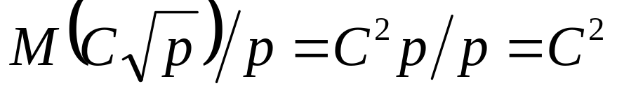
Isoefficiency Analysis
Sequential algorithm: Θ(n³)
Parallel overhead: Θ(√pn²)
Isoefficiency relation: n³ ≥ C √ pn² ⇒ n ≥ C √ p
This system is highly scalable

Slide 30
Summary
Considered two sequential algorithms
  Iterative, row-oriented algorithm
  Recursive, block-oriented algorithm
  Second has better cache hit rate as n increases
Developed two parallel algorithms
  First based on rowwise block striped decomposition
  Second based on checkerboard block decomposition
  Second algorithm is scalable, while first is not

